Slide 1
Computer Fundamentals

Slide 2
Basic Computer Science

Slide 3

By the end of this lesson, you will be able to:
Elaborate Computer Fundamentals
Elaborate Operating System
Classify Network Fundamentals
Explain Computer Security

Slide 4
Computer Fundamentals

Slide 5
Computer Fundamentals
A computer is an electronic device that accepts data and processes it into useful information.
There are two main aspects of the computer:
Input:
The data entered into a computer is called the input.
Inputs are raw facts for which the system processes and gives results.
Output:
The output is the result that the computer provides in return of the raw data entered.
Input
Process
Output
Notes:
An electronic device that accepts data and processes it into useful information.
There are two main aspects of the computer:
Input:
The data we enter the computer is called the input.
Inputs are raw facts for which we want the system to process and give us result.
Output:
The output is the result that the computer provides in return of the raw data entered.

Slide 6
Computer Fundamentals
Computer Devices
Input Devices
Keyboard
Mouse
Microphone
Touch screen
Light Pen
Web camera
Output Devices
Monitor
Printer
Speaker
CD
DVD
Storage Devices
Flash Memory
Optical Disk
Local drives
Magnetic type
Processing Devices
Mother Board
Processor
Random Access Memory
Read Only Memory
Switched Mode Power Supply

Slide 7
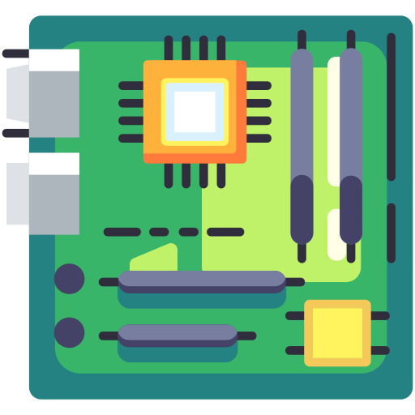
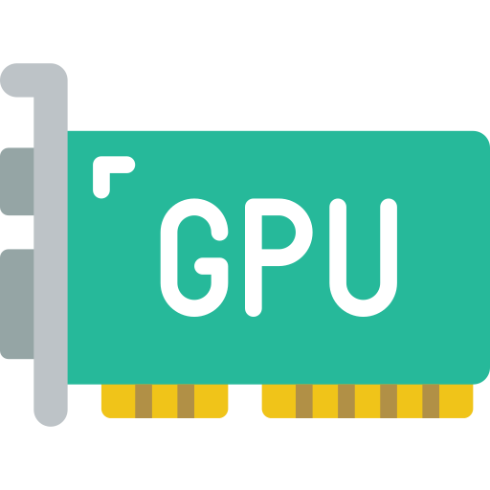
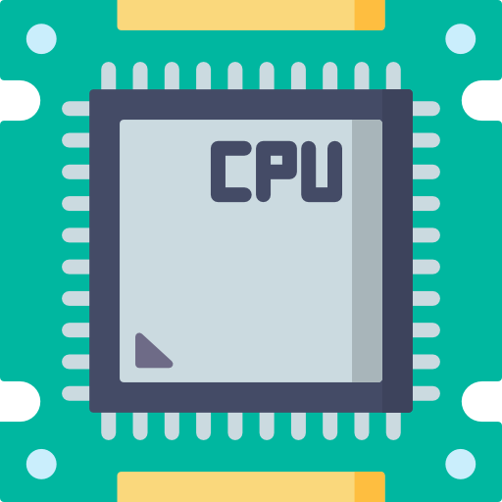
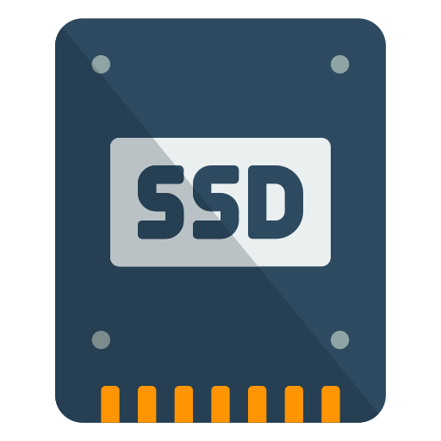
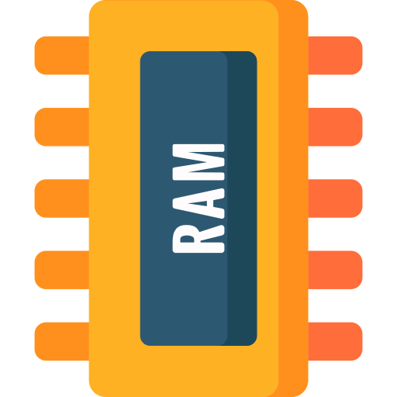
Computer Components
The five main components that make up a typical, present-day computer include:
Motherboard
Central Processing Unit (CPU)
Graphics Processing Unit (GPU)
Solid State Drive (SSD)
Random Access Memory (RAM)
Notes:
Whether it's a gaming system or a home PC, the five main components that make up a typical, present-day computer include:
A motherboard
A Central Processing Unit (CPU)
A Graphics Processing Unit (GPU), also known as a video card
Random Access Memory (RAM), also known as volatile memory
Storage: Solid State Drive (SSD) or Hard Disk Drive (HDD)

Slide 8
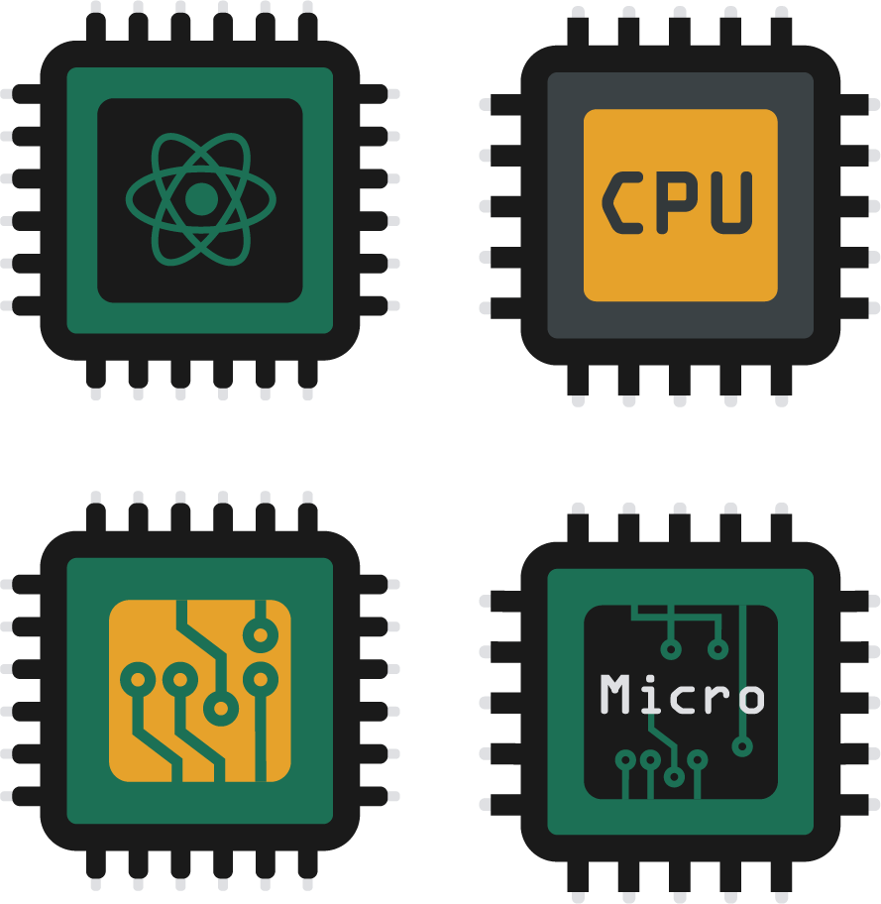
Computer Memory
The performance of a computer system depends upon the memory and CPU. A CPU is capable of storing only instructions required to operate the computer. Therefore, it is mandatory to have the memory to run a computer properly.
Notes:
The performance of computer system depends upon the memory and CPU. CPU is capable to store only instructions required to operate the computer. Therefore, it is mandatory to have the memory to run a computer properly.

Slide 9
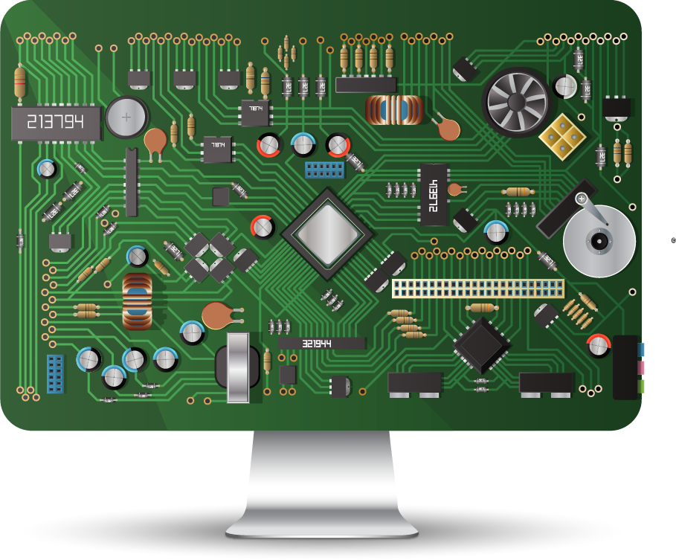
Computer Memory
Memory is a set of memory cells known as the building block of memory. Each memory cell has a unique index number or identification number known as the unique address of the specific memory cell.
A computer system is built using a combination of these types of computer memory, and the configuration can be optimized to produce the maximum data processing speed, the minimum cost, or some compromise between these two.
Notes:
Memory is a set of memory cells known as building block of memory. Each memory cell has a unique index number or identification number known as the unique address of that specific memory cell.
A computer system is built using a combination of these types of computer memory, and the configuration can be optimized to produce the maximum data processing speed or the minimum cost, or some compromise between these two.

Slide 10
Computer Memory Hierarchy
Computer Memory
Primary Memory
Secondary Memory
RAM
ROM
HDD
SSD
SRAM
DRAM

Slide 11

Number System
The number system is the technique to represent numbers in the computer system architecture. Every value that a user is saving into or getting from computer memory has a defined number system.
Computer architecture supports following number systems:
Binary number system (Base – 2)
Octal number system (Base – 8)
Decimal number system (Base – 10)
Hexadecimal (hex) number system (Base – 16)
Notes:
The number system is the technique to represent numbers in the computer system architecture. Every value that a user is saving into or getting from computer memory has a defined number system.
Computer architecture supports following number systems:
Binary number system (Base – 2)
Octal number system (Base – 8)
Decimal number system (Base – 10)
Hexadecimal (hex) number system (Base – 16)

Slide 12
Number System
Computer architecture supports following number systems:
Number system | Base | Used digits | Example | Language assignment
Binary | 2 | 0, 1 | (11110000)₂ | int val=0b11110000;
Octal | 8 | 0, 1, 2, 3, 4, 5, 6, 7 | (360)₈ | int val=0360;
Decimal | 10 | 0, 1, 2, 3, 4, 5, 6, 7, 8, 9 | (240)₁₀ | int val=240;
Hexadecimal | 16 | 0, 1, 2, 3, 4, 5, 6, 7, 8, 9, A, B, C, D, E, F | (F0)₁₆ | int val=0xF0;

Slide 13
Operating System

Slide 14

What Is an Operating System?
An operating system is a unit of system software that manages a computer's resources, such as hardware and software.
It is a piece of software that serves as a link between the user and the computer hardware.
Notes:
An operating system is a unit of system software that manages a computer's resources, such as hardware and software.
It is a piece of software that serves as a link between the user and the computer hardware.

Slide 15



What Is an Operating System?
Any software or application in a computer system must run on at least one operating system. An application, such as Microsoft Word, Chrome, or games, requires an environment in order to execute and fulfill its duties.
Notes:
Any software or application in a computer system must run on at least one operating system. An application, such as Microsoft Word, Chrome, or games, requires an environment in order to execute and fulfill its duties.

Slide 16

What Is an Operating System?
With the help of an operating system, communication between devices and applications may be done easily with the computer without learning computer languages.
Any computer or smartphone device cannot operate without an operating system.
Notes:
With the help of an operating system, communication between devices and applications may be done easily with the computer without learning computer languages.
Any computer or smartphone device cannot operate without an operating system.

Slide 17
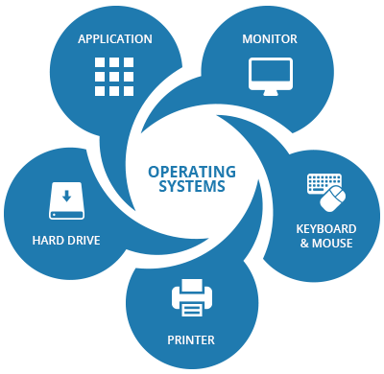
Operating System
The devices for communication are :

Slide 18
Objectives of an Operating System
1
The operating system offers an appropriate interface to use the computer system.
It helps in hiding the information related to the hardware resources from the users.
2
3
It provides the sharing of resources among users and programs in an efficient way.
The operating system helps us to manage the computer system resources.
4
5
The operating system offers convenient & impartial sharing of resources between the users & programs.
The operating system is useful to monitor and handle the execution of other programs.
6
Notes:
The objectives for operating system are:
The operating system offers an appropriate interface to use the computer system.
It helps in hiding the information related to the hardware resources from the users.
It provides the sharing of resources among users and programs in an efficient way.
The operating system helps us to manage the computer system resources.
The operating system offers convenient & impartial sharing of resources between the users & programs.
The operating system is useful to monitor and handle the execution of other programs.

Slide 19
Features of an Operating System
Error detecting aids
File and device management
Security and authentication
04
03
05
Processor management
Job accounting
02
06
Memory
management
OS
Control over system performances
01
07
Notes:
The features of an operating system:
Memory management
Processor management
File and device management
Error detecting aids
Security and authentication
Job accounting
Control over system performances

Slide 20
Features of an Operating System
Main memory stores data and programs that can be lost when the system is turned off. It is also known as Versatile Memory.
A processor is defined as an integrated electronic circuit which performs the job of calculations in the computer.
Main Memory
Processor
The system bus is responsible for communication between the processors, input-output modules, and main memory.
The task of I/O modules is to move the data within the computer to its peripheral external environment.
System Bus
I/O Modules

Slide 21
Network Fundamentals

Slide 22
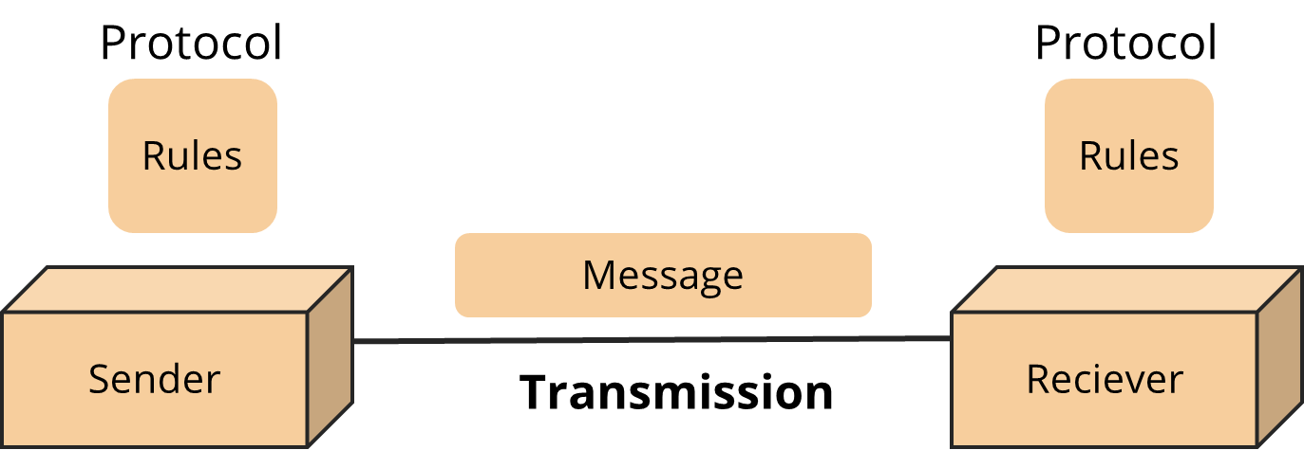
Introduction to Computer Networks
A computer network is a group of devices, such as computers, printers, scanners, that are connected to each other via wires, cables, and so on. These devices are also known as nodes.
It helps in sending and receiving data stored in devices over the network.
Notes:
A computer network is a group of devices, such as computers, printers, scanners, that are connected to each other via wires, cables, and so on. These devices are also known as nodes.
It helps in sending and receiving data stored in devices over the network.

Slide 23

Computer Networks Features
1
Performance
2
Data Sharing
3
Backup
4
Reliable
5
Security
6
Scalability
7
Software/Hardware Compatibility
Notes:
Computer network features are:
Performance
Data Sharing
Backup
Reliable
Security
Scalability
Software/Hardware Compatibility

Slide 24

Computer Networks
Some techniques to assess performance are:
Transit time: The time it takes for a message to go from one device to another
Response time: The time elapsed between an inquiry and a response
Performance can also be measured in other ways:
Number of users
Efficacy of software
Connected hardware's capabilities
Notes:
Some techniques to assess performance are:
Transit time: The time it takes for a message to go from one device to another
Response time: The time elapsed between an inquiry and a response
Performance can also be measured in other ways:
Number of users
Efficacy of software
Connected hardware's capabilities

Slide 25
Communication Model
Source
Transmitter
Transmission System
Receiver
Destination
Model | Description
Source | Data to be transmitted is generated by devices such as telephones, personal computers, and so on.
Transmitter | It transforms and encodes data in a way that electromagnetic waves or signals are produced.
Transmission System | The transmission system is as simple as a single line or as complicated as a complex network that connects source and destination.
Receiver | It accepts signals from the transmission system and translates them into a format that the destination can understand.
Destination | The receiver's data is delivered to the destination.
Notes:
The communication model are as the follows.

Slide 26
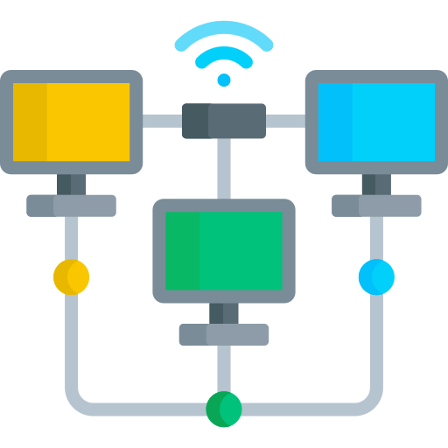
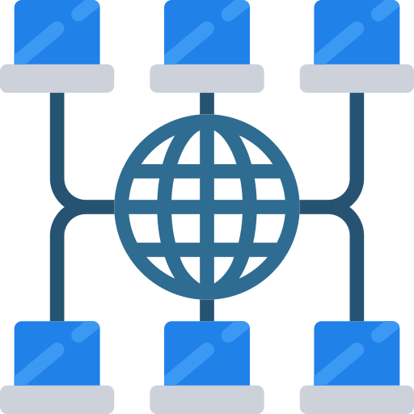
Network Topology
Network topology is the configuration of a network that includes nodes and connecting lines via sender and receiver.
Notes:
Network topology is the configuration of a network that includes nodes and connecting lines via sender and receiver.

Slide 27
Network Topology
Based on geographical area covered
Based on Architecture
Bus Topology
They are divided into two categories:
Geographical areas covered
Network architecture
LAN
Star Topology
MAN
Ring Topology
WAN
Tree Topology
Mesh Topology
Hybrid Topology
Notes:
They are divided into two categories:
Geographical areas covered
Network architecture

Slide 28
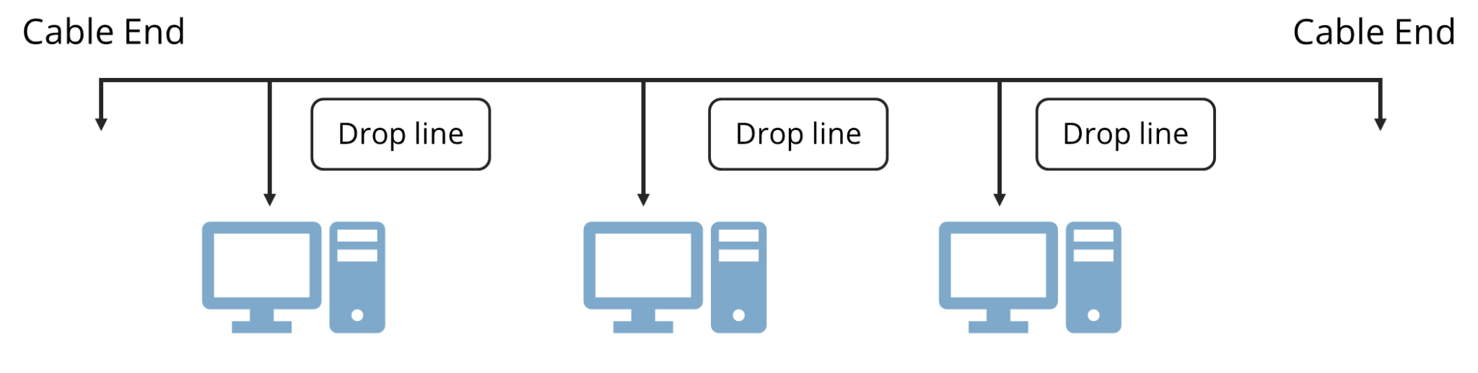
Bus Topology
Bus topology is a network type in which every computer and network device is connected to single cable. When it has exactly two endpoints, then it is called Linear Bus topology.
Notes:
Bus topology is a network type in which every computer and network device is connected to single cable. When it has exactly two endpoints, then it is called Linear Bus topology.

Slide 29
Bus Topology
The advantages and disadvantages of bus topology are:
Advantages
Disadvantages
It is easy to set up.
The bus uses less cabling than the mesh, star, and tree topologies.
Reconfiguring and isolating errors is difficult.
All communication is disrupted when a bus cable malfunctions or breaks.
Notes:
The advantages and disadvantages of bus topology are:
Advantages
It is easy to set up.
The bus uses less cabling than the mesh, star, and tree topologies.
Disadvantages
Reconfiguring and isolating errors is difficult.
All communication is disrupted when a bus cable malfunctions or breaks.

Slide 30
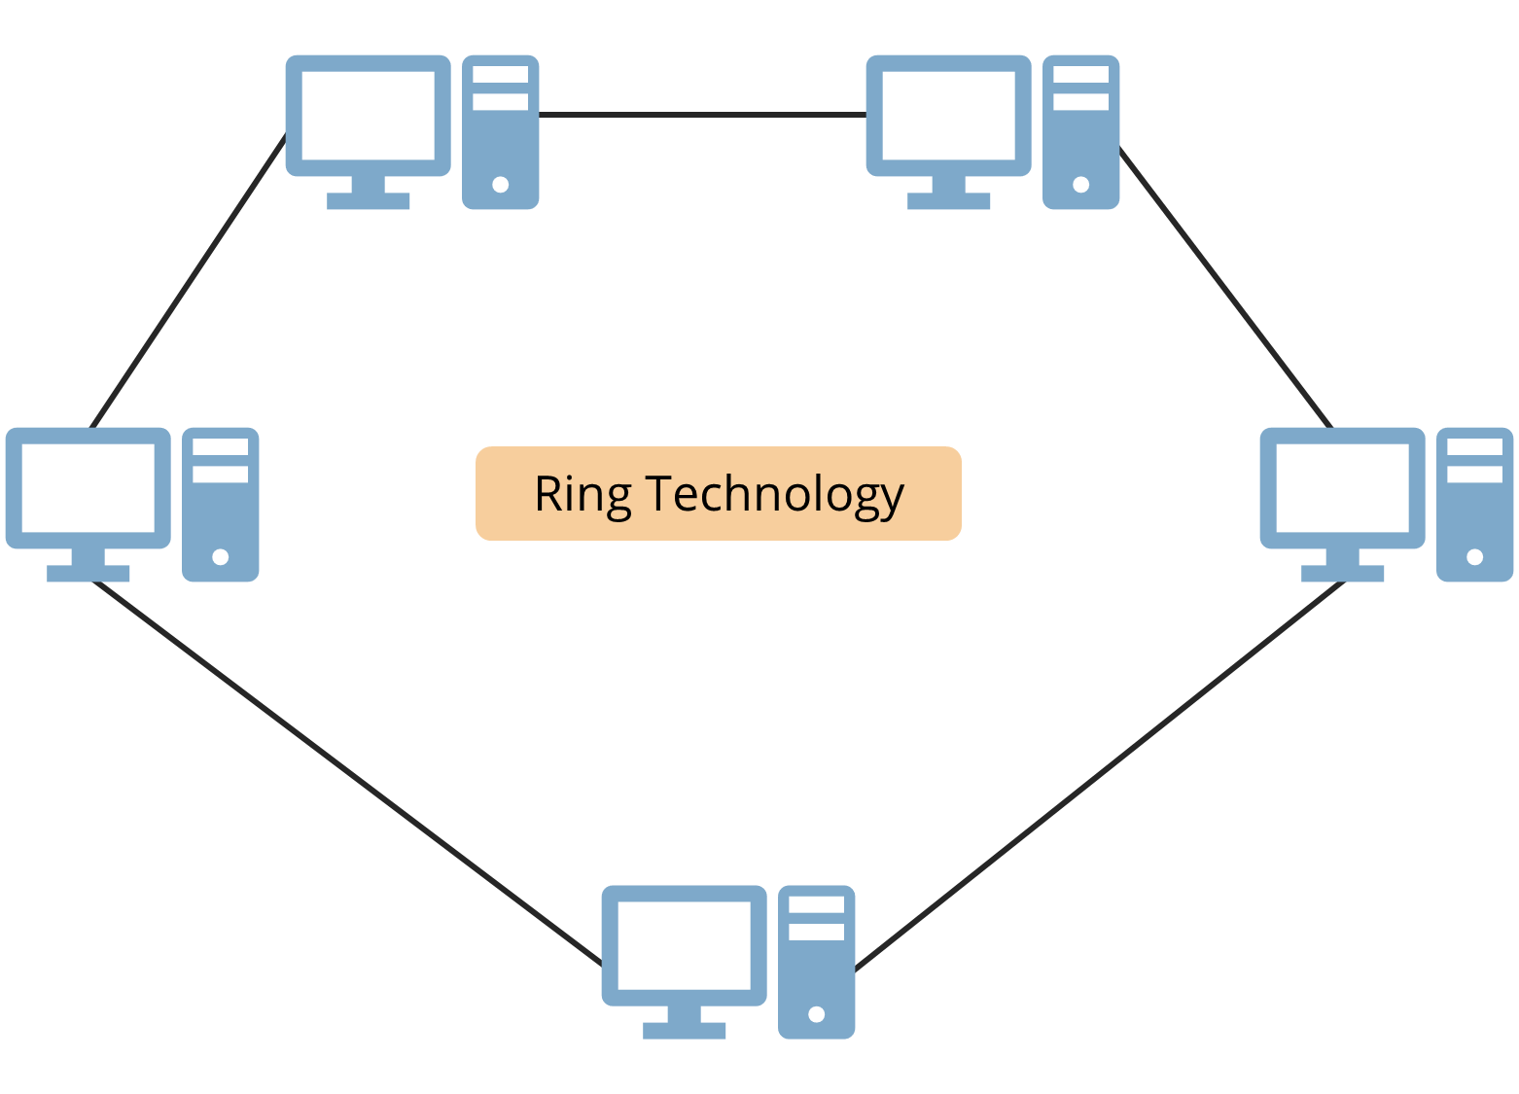
Ring Topology
Ring topology is called so because one computer connected to another, with the final one being connected to the first. Each device has exactly two neighbors.
Notes:
Ring topology is called so because one computer connected to another, with the final one being connected to the first. Each device has exactly two neighbors.

Slide 31
Advantages and Disadvantages
The advantages and disadvantages of ring topology are:
Advantages
Disadvantages
Although packets only move in one direction, data transmission is comparatively simple.
A central controller is not required to manage communication between nodes.
A data packet in a unidirectional Ring must pass through all nodes.
For computers to communicate with one another, they must all be turned on.
Notes:
The advantages and disadvantages of ring topology are:
Advantages
Although packets only move in one direction, data transmission is comparatively simple.
A central controller is not required to manage communication between nodes.
Disadvantages
A data packet in a unidirectional Ring must pass through all nodes.
For computers to communicate with one another, they must all be turned on.

Slide 32
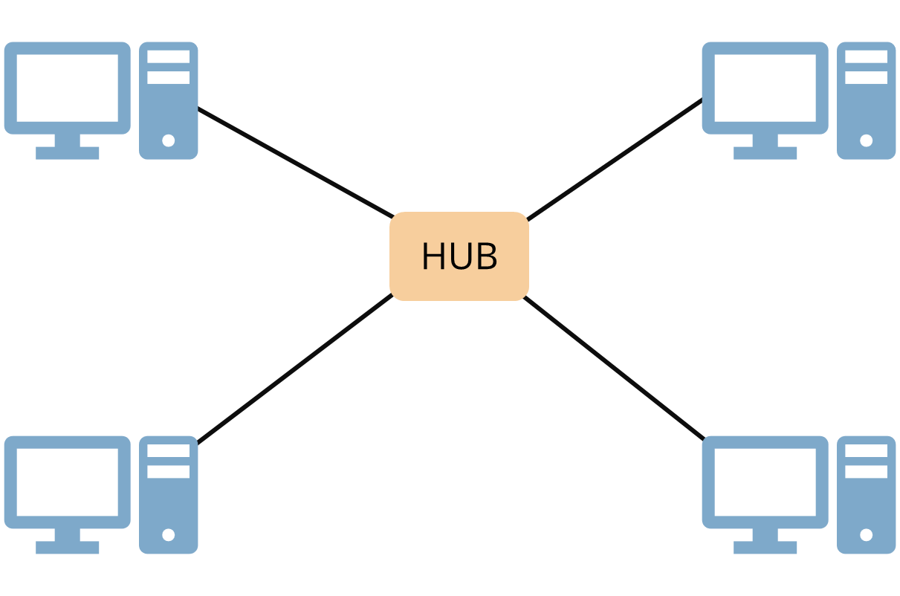
Star Topology
All the PCs in this configuration are connected to a single hub through a cable. This hub stands as the central node, with all other nodes connecting to it.
Notes:
All the PCs in this configuration are connected to a single hub through a cable. This hub stands as the central node, with all other nodes connecting to it.

Slide 33
Advantages and Disadvantages
The advantages and disadvantages of star topology are:
Advantages
Disadvantages
There are no network interruptions when connecting or disconnecting devices.
It is easy to install and configure.
The process of identifying and isolating defects is straightforward.
If the hub, switch, or concentrator fail, the nodes attached to them are considered failed.
It is more expensive than linear bus topologies due to the cost of the hubs.

Slide 34
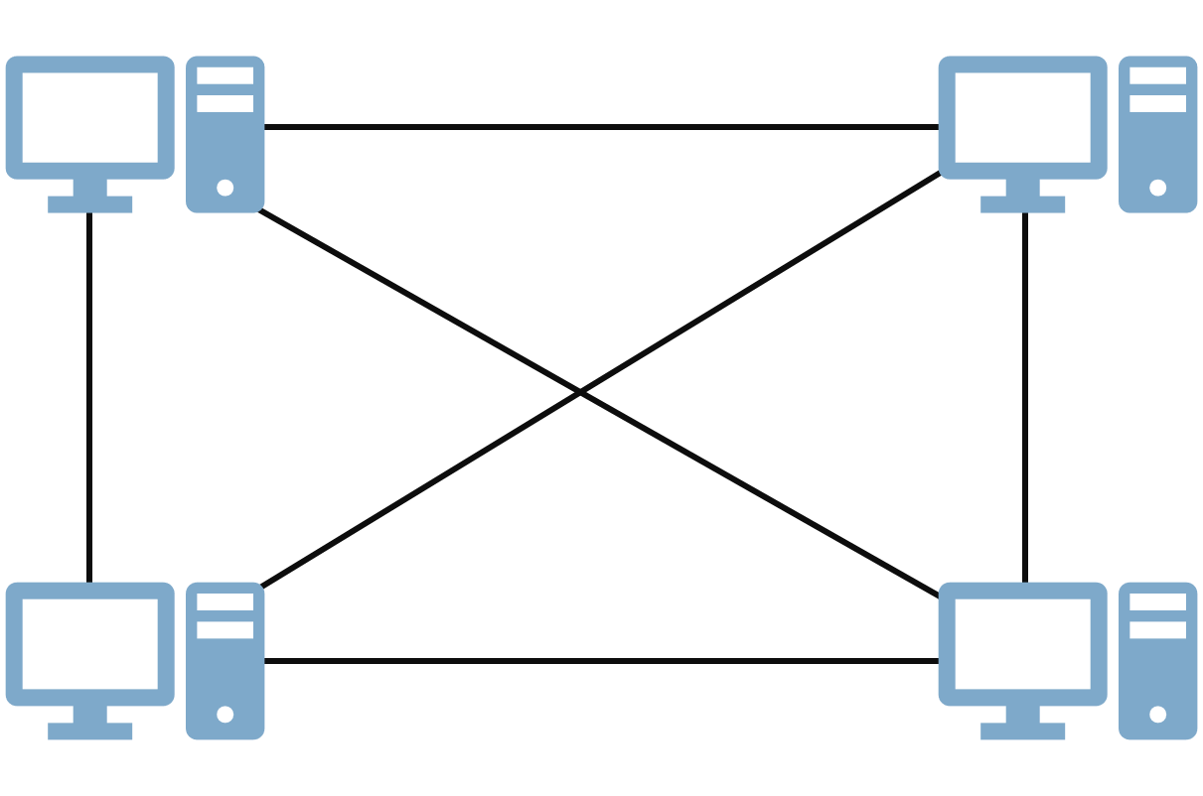
Mesh Topology
It is a connection between two nodes or devices, which is point-to-point. All the network nodes are linked. To connect n devices, Mesh has n(n-1)/2 physical channels.

Slide 35
Advantages and Disadvantages
The advantage and disadvantages of mesh topology are:
Advantages
Disadvantages
Various devices can transmit data at the same time. This topology can handle a large amount of traffic.
Even if one of the connections fails, there is always a backup connection. Data transmission is unaffected as a result.
A huge amount of cabling and the number of I/O ports is required.
It is challenging to set up and customize.

Slide 36
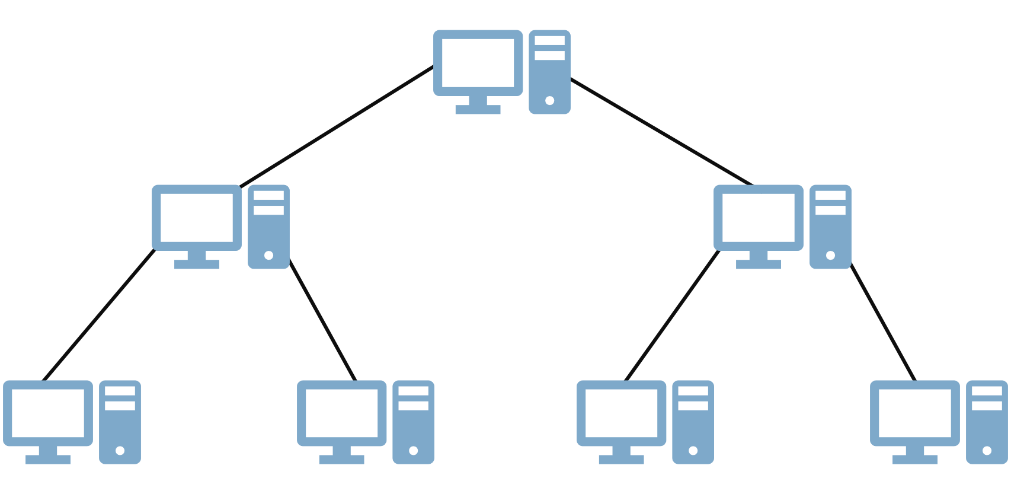
Tree Topology
It does have a cluster center that is linked to all other nodes, creating a hierarchy. It is also known as Hierarchical topology. The hierarchy should have at least three tiers.

Slide 37
Advantages and Disadvantages
The advantage and disadvantages of tree topology are:
Advantages
Disadvantages
Expansion of the network is both possible and simple.
We divide the network into smaller portions (star networks) to make it easier to operate and maintain.
If one section is damaged, the others are untouched.
For its basic form, tree topology relies heavily on the main bus wire, and if it breaks, the entire network is hampered.
When more nodes and segments are introduced, maintenance becomes more difficult.

Slide 38
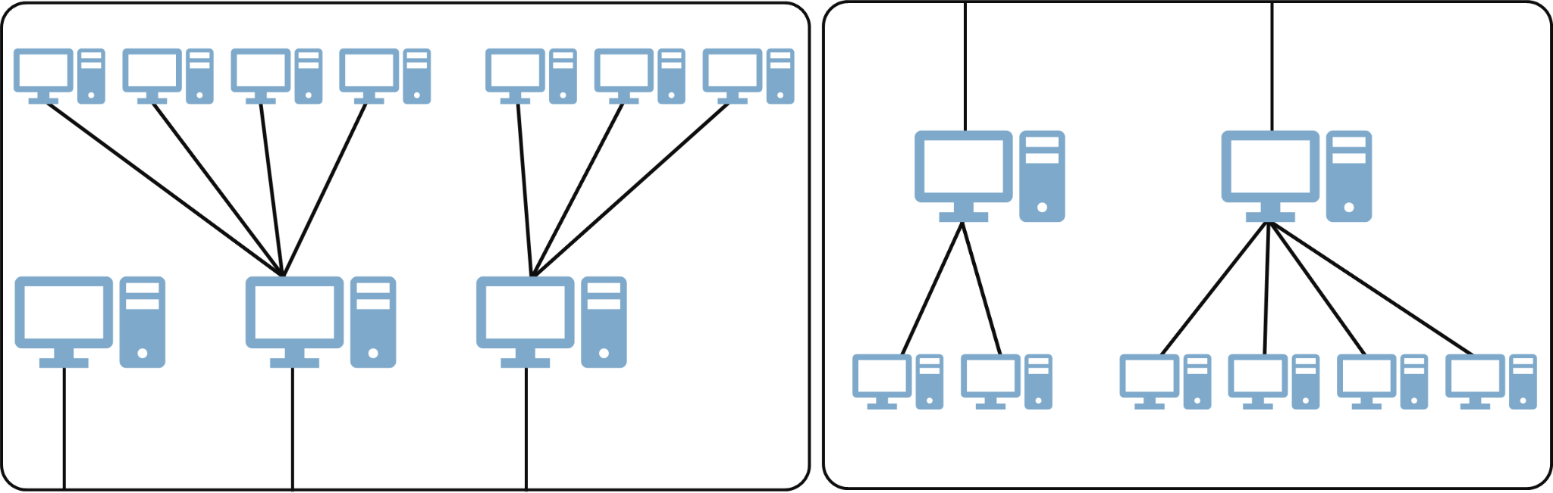
Hybrid Topology
It is a mixture of two or more topologies. For example, in an office, if one department uses ring topology and another uses star topology, connecting these topologies will result in Hybrid Topology (ring topology and star topology).

Slide 39
Advantages and Disadvantages
The advantage and disadvantages of hybrid topology are:
Advantages
Disadvantages
This form of topology integrates the advantages of various topologies into a single topology.
It is quite dependable.
It is highly adaptable as hybrid networks are built in such a way that new hardware components can be easily integrated.
It is simple to spot errors and troubleshoot them.
It is a high-priced network type.
The creation of a hybrid network is a difficult task.
In order to link one topology to another, hardware must be changed.
Hybrid architectures are typically larger in scale, necessitating a high number of wires during the installation procedure.

Slide 40
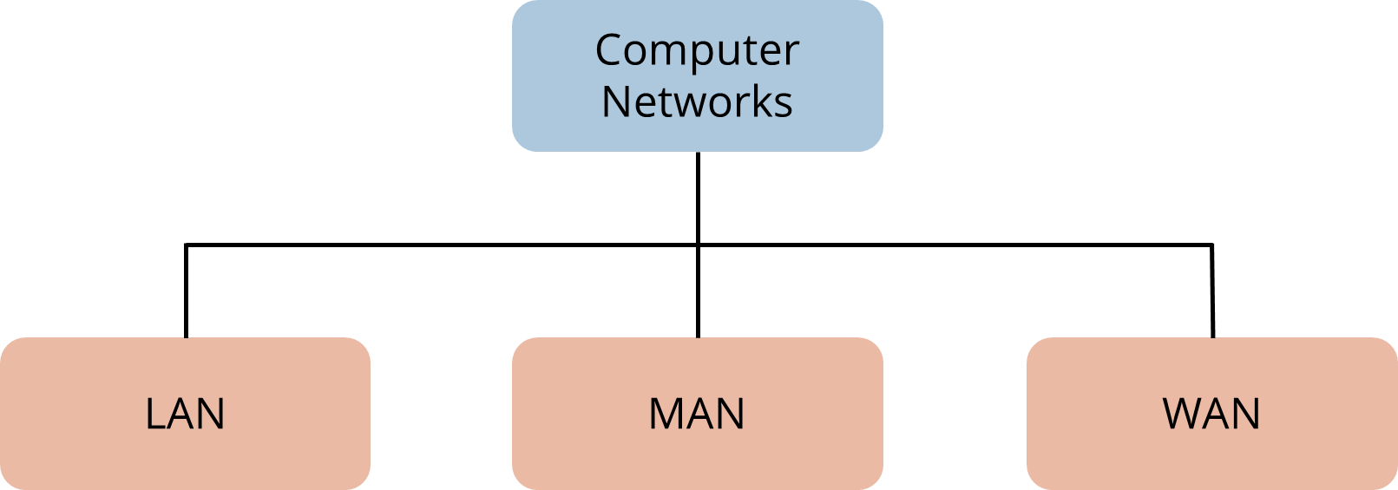
Computer Network Types
A computer network is a group of computers connected with each other through a transmission medium such as cable, wire, and so on.
A computer network can be categorized by its size and is mainly of three types:

Slide 41
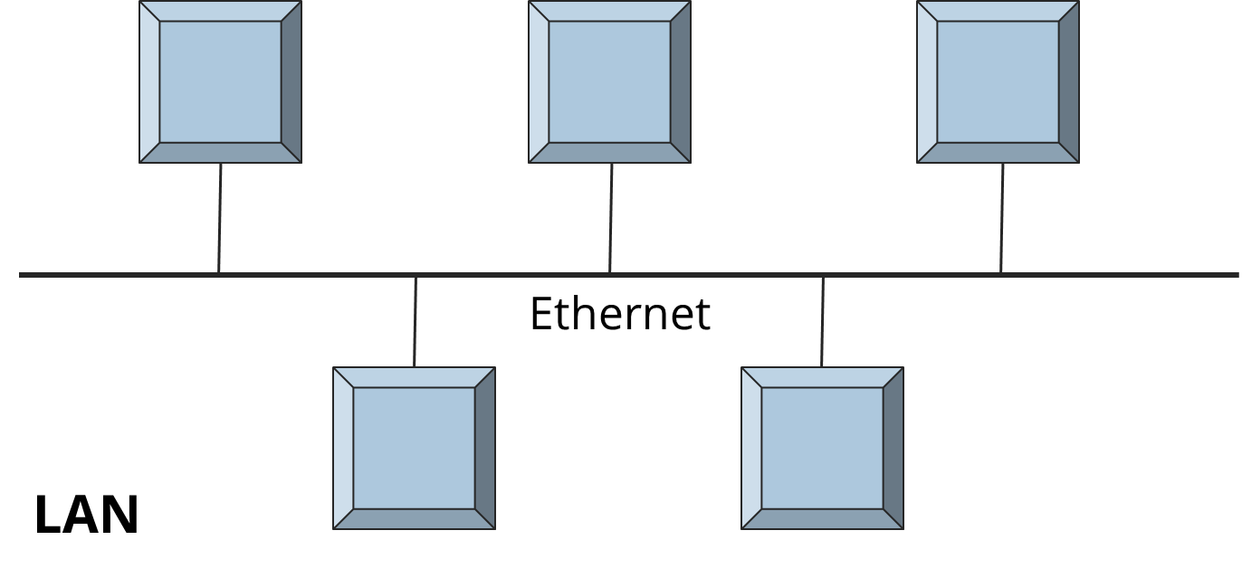
LAN (Local Area Network)
LAN is a group of computers connected with each other in small places and is best suited for schools, hospitals, apartments and so on.
Due to its small size, LAN works faster, with its speed between 10 to 100 Mbps. It can transfer data with a speed ranging from 4 to 16 Mbps.

Slide 42
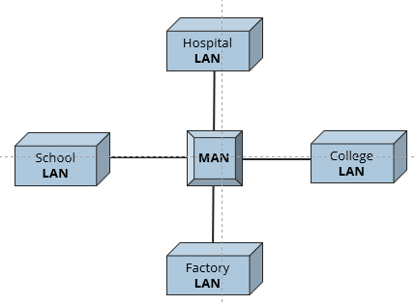
MAN (Metropolitan Area Network)
In MAN, various LANs are connected to each other through telephone lines. It is mainly held and operated by a single private or public company.
The size of the MAN is larger than LANs and smaller than WANs. A MAN covers the larger area of a city or town that is around 50 Kms.

Slide 43
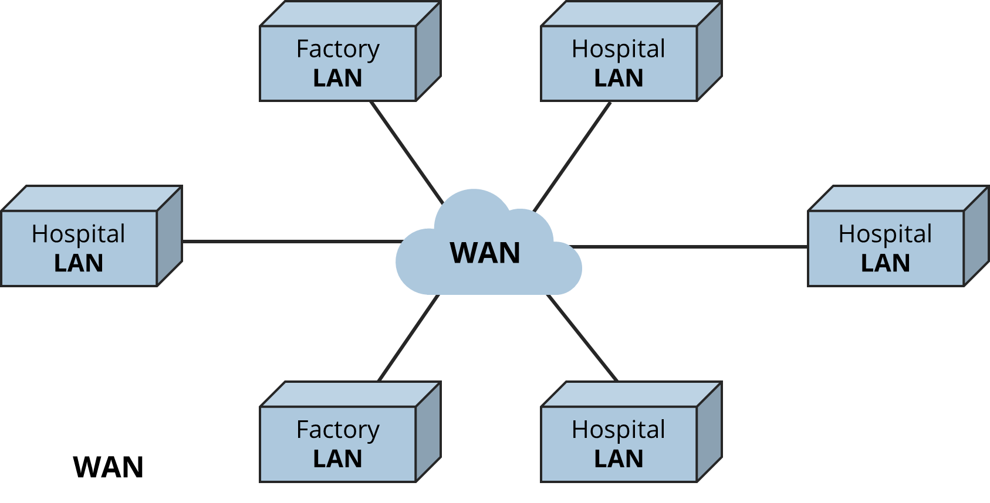
WAN (Wide Area Network)
WAN provides long distance transmission of data, and its size is larger than LAN and MAN. It can cover a country, continent, or even the whole world
The medium of communication used by WAN is PSTN or Satellite links. Some examples are Internet and Broadband Mobile Connections, such as 3G or 4G.

Slide 44
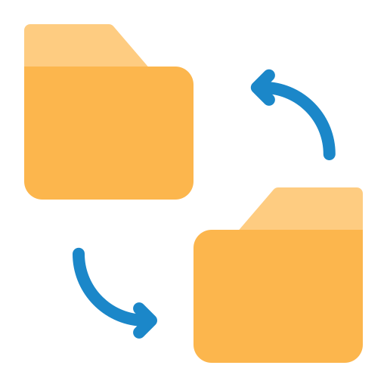
Transmission Modes
A transmission mode is a mechanism of transferring the data between two devices. These devices or nodes must relate or connect to each other.
It is also called communication mode. The modes direct the direction of the flow of information. The transmission mode is defined in the physical layer.

Slide 45
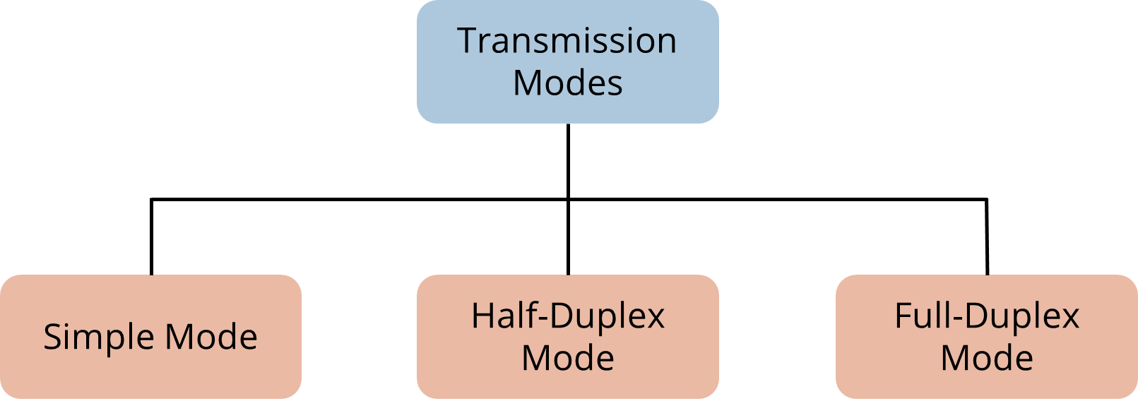
Transmission Modes
The transmission mode is divided into three categories:

Slide 46
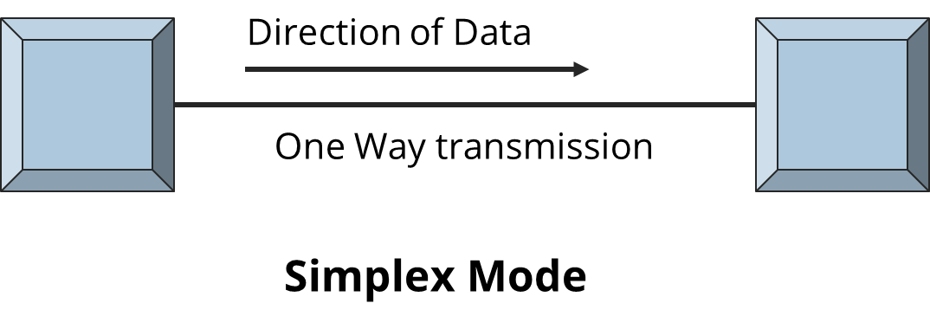
Simplex Transmission Mode
The features of simplex transmission mode are:
In simplex mode the data transmits in one direction only.
This transmission mode is also known as unidirectional transmission.
The sender device can only send data and cannot receive it, whereas the receiver device can only receive the data and cannot send it.
For example, a television demonstrates simplex mode.

Slide 47
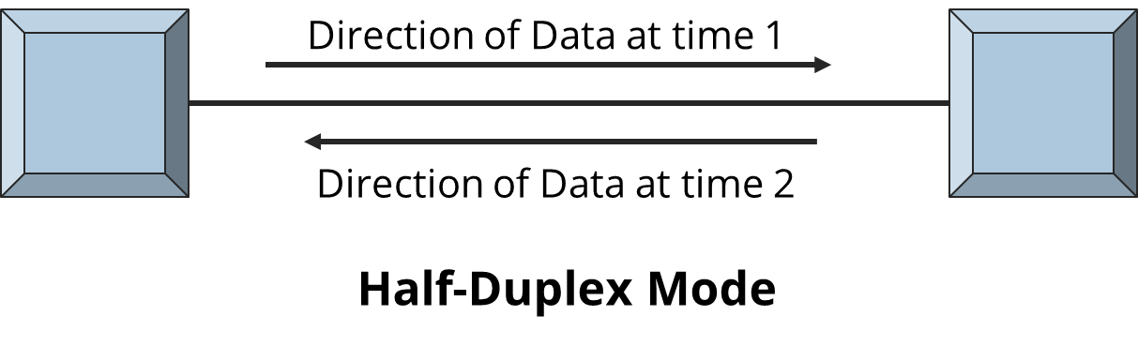
Half-Duplex Transmission Mode
The features of simple transmission mode are:
In half-duplex mode, transmission can be done both ways.
Two connected devices can send and receive data at different times.
An example of a half-duplex is a walkie-talkie in which one message is sent at a time, but multiple messages are sent in both directions.

Slide 48
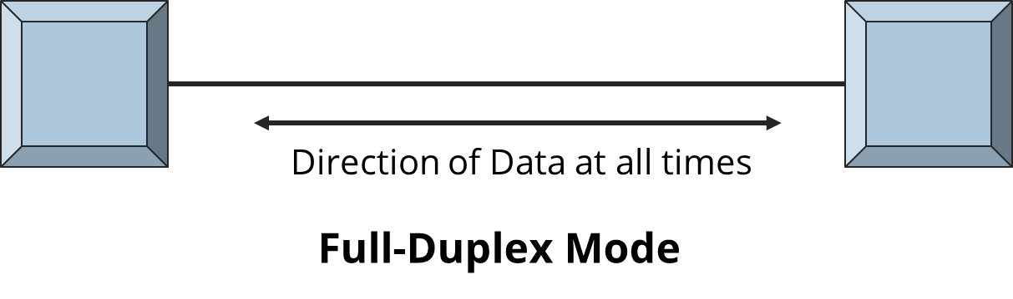
Full-Duplex Transmission Mode
The features of simple transmission mode are:
In this mode, data can be sent in both directions at the same time.
There is no delay in communication as both can send and receive data simultaneously.
An example of a Full Duplex is a Telephone Network, that is, communication between two persons by a telephone line, using which both can talk and listen at the same time.

Slide 49
Internet

Slide 50


Internet
The Internet is a global system of interconnected computer networks. It uses a standard Internet Protocol (IP) suite to link several devices.
It is an international network of network, linked by optical, wireless, and electronic networking technologies.
It consists of business, public, educational, and government networks.

Slide 51


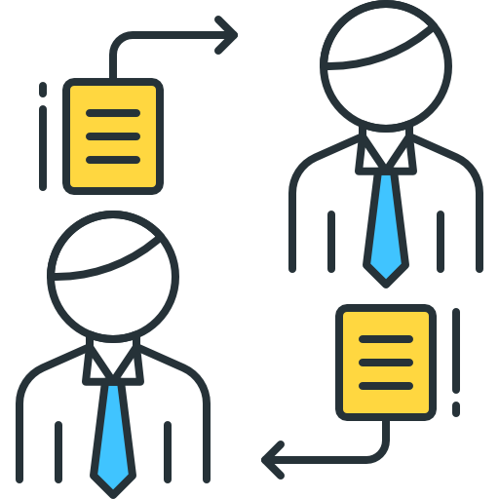
Internet
It carries an extensive range of information resources and utilizes:
IP Addressing Scheme
Transmission Control Protocol (TCP)
Peer2Peer (P2P) networks for file sharing

Slide 52
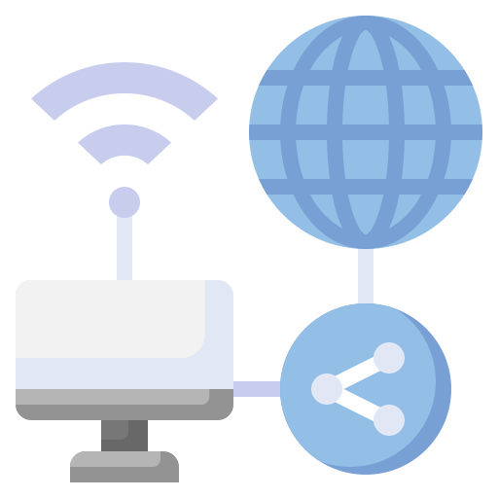
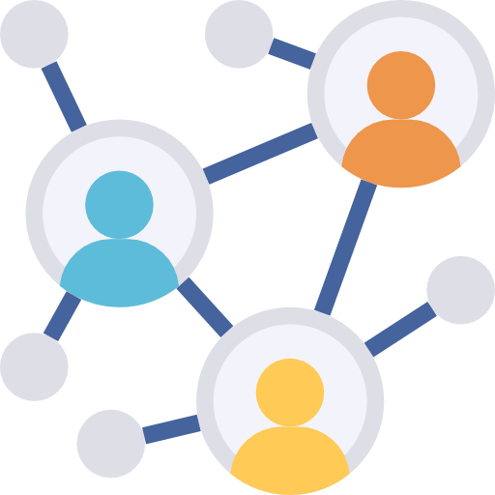
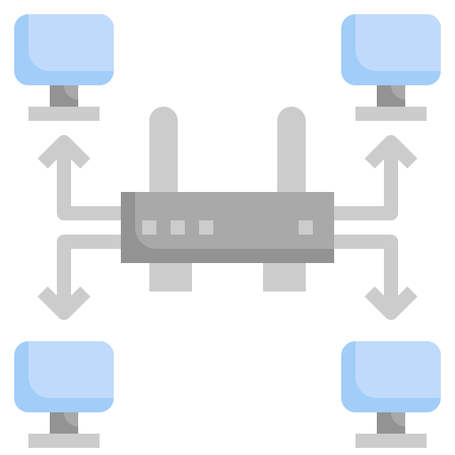
Intranet
An intranet is a private network that is contained within an enterprise. It consists of interlinked LAN and uses WAN for network connectivity.
Its purpose is to share company information among employees. It is usually created and maintained by a private organization, and the content is intended for the members of the organization only.

Slide 53
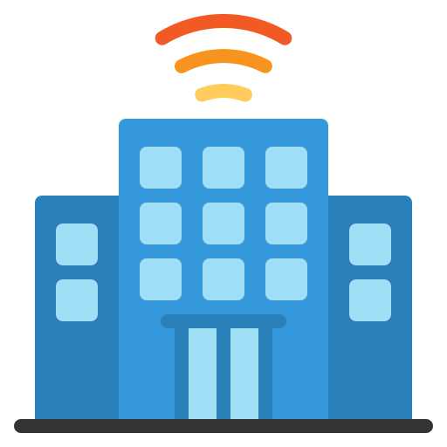

Extranet
Extranet uses internet protocols to link intranet over the public internet. It is a part of a company's intranet that is extended to users outside the company, such as suppliers, vendors, partners, customers, and so on.
Some examples are placing of purchase order to registered vendors, billing & invoices, payments related activities, joint venture related activities, product brochures for partners, discounted price lists for partners, and so on.

Slide 54
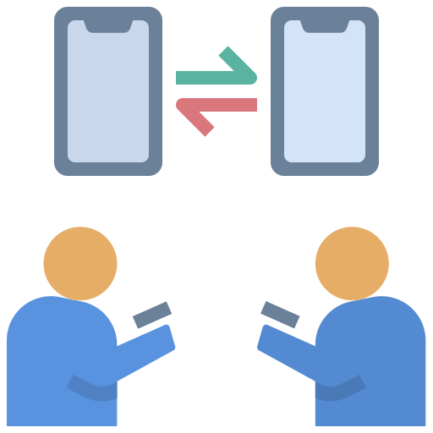


Extranet
Extranet can be used to:
Exchange large volume of data
Collaborate with partners & Peers
Share Product Catalogs

Slide 55
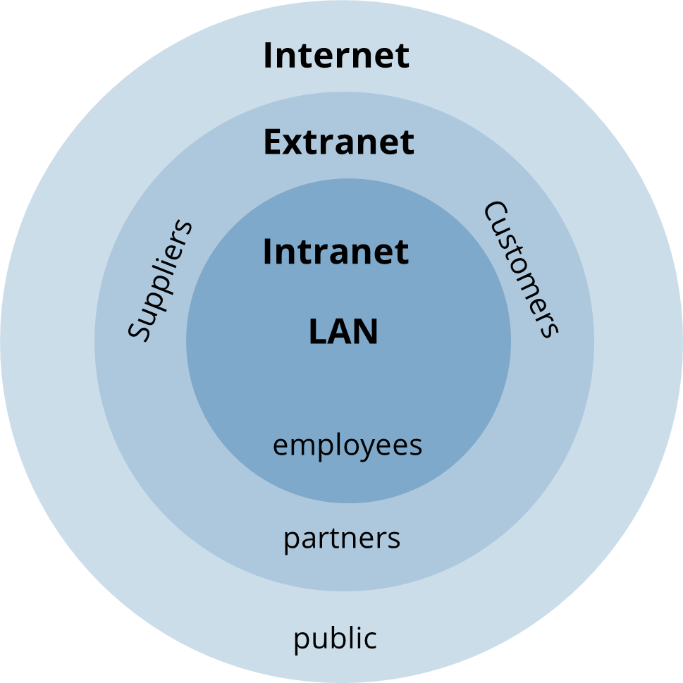
Internet, Intranet, and Extranet
The subset of internet, intranet and extranet is:

Slide 56


Email
Email is a way to send and receive messages across the Internet. Each user of email is assigned a unique name for their email account.
An email address is generally written as username@domainname.
For example, king.kochhar@abc.com is an email address.
The username and the domain name are separated by @ (at) symbol.
Email addresses are not case sensitive. Spaces are not allowed in email address.

Slide 57
Email
The advantages of email are :
Email is usually packaged with a calendar, address book, instant messaging, and so on for convenience and productivity.
To sign up for an account like Facebook or services like Amazon, a user will need an email address to be safely identified and contacted.
Productivity Tools
Access to Web Services
Email service providers have tools that allow users to file, label, prioritize, find, group, and filter their emails for easy management. They can even control spam or junk emails.
Easy Mail Management

Slide 58


Email
The advantages of email are :
A user can send an email to multiple people at once, with an option to include as few or as many people required in the conversation.
A user does not have to be at home to get the email. They can access it from any computer or cell phone that has an Internet connection.
Communication with People
Anywhere Anytime

Slide 59

WebMail Providers
The top three webmail providers are Yahoo!, Outlook.com, and Google's Gmail. These providers allow you to access your email account from anywhere.
There are several email service providers available in the market with their enabled features, such as sending, receiving, drafting, storing an email, and so on.
Notes:
The top three webmail providers are Yahoo!, Outlook.com, and Google's Gmail.
These providers allow you to access your email account from anywhere
There are several email service providers available in the market with their enabled features such as sending, receiving, drafting, storing an email and much more.

Slide 60
Computer Security

Slide 61



What Is Computer Security?
Computer security is the protection of computer systems and information from unauthorized use, which allows a user to use the computer while keeping it safe from threats.
It secures the personal information and the overall health of the computer. Adequate computer security helps prevent viruses and malware, allowing programs to perform faster and more smoothly.
Notes:
It is the protection of computer systems and information from unauthorized use.
There are various computer security measures to protect the valuable information.
Computer security allows to use the computer while keeping it safe from threats.
Computer protection is essential because it secures your personal information.
It's also crucial for the overall health of your computer; adequate computer security helps prevent viruses and malware, allowing programmes to perform faster and more smoothly.

Slide 62
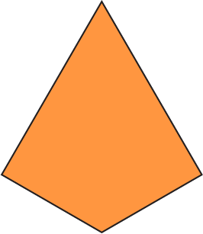
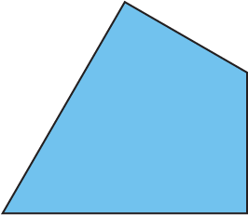
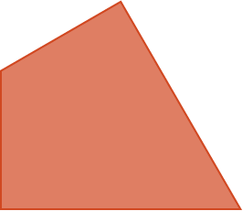
CIA Triad in Security
Since the first mainframes, the industry standard for computer security has been Confidentiality, Integrity, and Availability.
Integrity
Confidentiality
Availability

Slide 63
CIA Triad in Security
Confidentiality:
Ensuring that data is unavailable to unauthorized parties, usually using encryption, IDs, and passwords
Integrity:
Preventing unauthorized parties from altering information and systems and guaranteeing that the protected data is correct and reliable
Availability:
Ensuring that authorized persons have access to information when they need it, keeping them up to date on upgrades, and employing backups to prevent disruptions or data loss among other things

Slide 64
Computer Fundamentals has three main aspects: Input, Output, and Computer Memory.
An Operating System is a unit of system software that manages a computer's resources, such as hardware and software.
A computer network is a group of devices connected to each other.
Computer security allows a user to use the computer while keeping it safe from threats.

Slide 66
Which of the following is not considered hardware?
1
Operating System
CPU
Keyboard
Hard Disk

Slide 67
Which of the following is not considered hardware?
1
Operating System
CPU
Keyboard
Hard Disk
A
The operating system (OS) is a software that acts as an interface between a computer and a user.

Slide 68
What is five main components of a computer system?
2
CPU, CD-ROM, Mouse, Keyboard, and Sound card
Memory, Video card, Monitor, Software, and Hardware
Modem, Keyboard, Word Processor, Printer, and Screen
None of the above

Slide 69
What is five main components of a computer system?
2
CPU, CD-ROM, Mouse, Keyboard, and Sound card
Memory, Video card, Monitor, Software, and Hardware
Modem, Keyboard, Word Processor, Printer, and Screen
None of the above
D
The five components are Motherboard, CPU, GPU, SSD, and RAM.

Slide 70
Which is a term that refers to the way in which the nodes of a network are linked together?
3
Network
Topology
Connection
Interconnectivity

Slide 71
Which is a term that refers to the way in which the nodes of a network are linked together?
3
Network
Topology
Connection
Interconnectivity
B
Topology is a term that refers to the way in which the nodes are connected in a network.

Slide 72
Which of the following is NOT a type of transmission mode?
4
Physical
Simplex
Full Duplex
Half Duplex

Slide 73
Which of the following is NOT a type of transmission mode?
4
Physical
Simplex
Full Duplex
Half Duplex
A
Physical is not a type of transmission mode. There are three modes of transmission: simplex, half duplex, and full duplex.

Slide 74
What is the process of verifying the identity of a user called?
5
Authentication
Identification
Validation
Verification

Slide 75
What is the process of verifying the identity of a user called?
5
Authentication
Identification
Validation
Verification
A
Authentication is the process of verifying the identity of a user. It is typically based on passwords, smart cards, fingerprints, and so on.

Slide 76
Thank you

